Slide 1

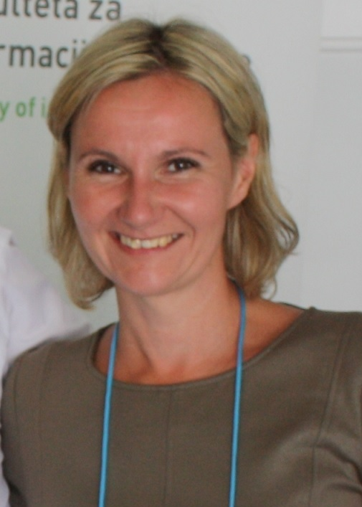



Prosumers’ Engagement in Business Process Innovation – The Case of Poland and UK
Ewa Ziemba Monika Eisenbardt
University of Economics, Katowice, Poland
Roisin Mullins Sandra Dettmer
University of Wales Trinity Saint David, United Kingdom
InSITE Conference 2019

Slide 2

Agenda
knowledge
sharing
business processes
Introduction
Theoretical background
Research methodology
Research findings
• First, we have identified how prosumers can be engaged in business processes through knowledge sharing.
• Second, we have found the differences between Poland- and UK-based prosumers in engagement in business process
Conclusions and recommendations

Slide 3
Underpinnings of our research
knowledge
sharing
Contemporary consumers want to be active co-creators of value and satisfy their consumption needs through collaboration with companies.
Many enterprises have detected the value of consumers’ knowledge in changing the consumers–business relationship.
Companies making use of prosumers’ knowledge and converting this into their innovative potential promote a paradigm of open innovation
The consumers who used to share knowledge are known as the prosumers

Slide 4

Nature of prosumtion
blur the traditional roles
of producers and consumers
consumers share knowledge with enterprises and enterprises can use this knowledge to produce things of value
knowledge sharing
utilize
knowledge,
creativity, innovativeness
“prosumption”
“co-creation” “co-production”

Slide 5
Research gap
knowledge
sharing
Research gap
prosumers’ role in innovations and their engagement in business processes
our study validates and compares prosumer engagement in business process innovations in the UK and Poland

Slide 6
Main research question
How do prosumers engage in business processes innovations through their knowledge sharing?
Research instrument
A survey questionnaire we developed to collect empirical data from PL-based and UK-based prosumers.
The questionnaire contained a question concerning specified types of prosumers engagement. The question was: Please indicate, what is your engagement with products’ or companies’ comments or development concerns?
The sample: 388 Polish and 76 UK prosumers

Slide 7
Specific research questions and hypotheses
RQ1: Are there statistically significant differences between Poland- and UK-based prosumers’ engagement in business process innovations?
To answer this question, the following hypothesis was developed:
H1: There are statistically significant differences between Poland- and UK-based prosumers’ engagement in business process innovations
RQ2: Are there statistically significant differences between Poland- and UK-based prosumers’ engagement which contribute to individual business process innovations?
To generate findings on this question, the following hypotheses were developed:
H2a: There are statistically significant differences between Poland- and UK-based prosumers’ engagement which contribute to BP2 innovations.
H2b: There are statistically significant differences between Poland- and UK-based prosumers’ engagement which contribute to BP3 innovations.
H2c: There are statistically significant differences between Poland- and UK-based prosumers’ engagement which contribute to BP4 innovations.
H2d: There are statistically significant differences between Poland- and UK-based prosumers’ engagement which contribute to BP5 innovations
.

Slide 8
The conceptual framework of prosumers’ engagement in business processes
Operational business processes | Types of prosumers engagement | Code
BP2 Develop and manage products | designing new products designing new functionalities of products improving materials from which products were made designing package or graphic elements of the product improving reliability and durability of products improving ease and intuitiveness of product usage improving effectiveness and efficiency of usage | e1 e2 e3 e4 e5 e6 e7
BP3 Market and sell products | designing advertising campaigns creating product pricing strategy creating product loans strategy | e8 e9 e10
BP4 Deliver products | establishing new channels of sale improving ordering process | e11 e12
BP5 Manage customer service | improving handling complaints and warranty services improving consumer service | e13 e14

Slide 9

… research methodology
Statistical analysis in order to confirm the research hypotheses
descriptive statistics: mean, median, mode, and standard deviation were employed to assess the ways in which prosumers share knowledge with enterprises and public organizations
non-parametric statistical tests Mann-Whitney U-Test was used to determine whether the hypotheses were supported by our empirical data

Slide 10
Findings of our research

Slide 11
H1: There are statistically significant differences between Poland- and UK-based prosumers’ engagement in business process innovations
Operational business processes
BP2 Develop and manage products
BP3 Market and sell products
BP4 Deliver products
BP5 Manage customer service
The Mann-Whitney U test indicated that there are statistically significant differences between Poland- and UK-based prosumers in their engagement in business processes innovations.
hypothesis H1 is supported in our study

Slide 12
H2a: There are statistically significant differences between Poland- and UK-based prosumers’ engagement which contribute to BP2 innovations
Seven types of engagement were analyzed
Types of prosumers engagement | Code
designing new products designing new functionalities of products improving materials from which products were made designing package or graphic elements of the product improving reliability and durability of products improving ease and intuitiveness of product usage improving effectiveness and efficiency of usage | e1 e2 e3 e4 e5 e6 e7
The Mann-Whitney U test indicated that there were significant differences between Poland- and UK-based prosumers in each type of engagement
H2a - supported

Slide 13
H2a: There are statistically significant differences between Poland- and UK-based prosumers’ engagement which contribute to BP2 innovations
The differences between Poland- and UK-based prosumers’ engagement in BP2 innovations
H2a - supported

Slide 14
H2b: There are statistically significant differences between Poland- and UK-based prosumers’ engagement which contribute to BP3 innovations
Three types of engagement were analyzed
Types of prosumers engagement | Code
designing advertising campaigns creating product pricing strategy creating product loans strategy | e8 e9 e10
The Mann-Whitney U test indicated that there were significant differences between Poland- and UK-based prosumers in the case of designing advertising campaigns as well as creating product pricing strategies
H2b – partially supported

Slide 15
H2b: There are statistically significant differences between Poland- and UK-based prosumers’ engagement which contribute to BP3 innovations
The differences between Poland- and UK-based prosumers’ engagement in BP3 innovations
H2b – partially supported

Slide 16
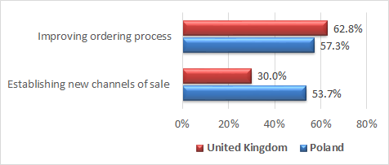
The differences between Poland- and UK-based prosumers’ engagement in BP4 innovations
The differences between Poland- and UK-based prosumers’ engagement in BP5 innovations

Slide 17
Main conclusions
The results clearly show that there are statistically significant differences between Poland- and UK-based prosumers’ engagement in business processes innovation
These differences might arise from the fact that the UK belongs to innovation leaders of the European Union (EU) with innovation performance well above that of the EU average, whereas the innovation performance of Poland is below that of the EU average and is classified as moderate innovators (EU, 2018)
Our findings suggest that organizational practices across cultural boundaries need tactical plans that foster knowledge sharing

Slide 18
Thank you for your attention
Contact:
monika.eisenbardt@ue.katowice.pl

